Slide 1


2019/2020
Organisational Report #1
Period covered: 1 April – 31 July 2019

Slide 2
How to read this report
This report is an combination of our ACW Funding Requirements proforma and our internal reporting requirements on both the organisational impact and outcomes we hope to achieve, plus our operational Measures of Success.
The targets featured are for year 1 (2019/2020) of the 3-year lifespan of the 2019-2022 Strategic Plan. These targets represent our ambitions, linked to the projects in our current activity and operational programme and current demographic, political, economic and social trends. Some of our projects are dependent on sourcing additional external funding, and some may be adapted or become unfeasible during the development process. Some projects will be affected by factors outside our direct control. For these reasons, these targets are a forecast of what success will look like and may be subject to reasoned revision.
The Senior Management Team receives this report plus another at a more granular project level which focuses on monthly progress towards KPIs. The Management Board can request to see this as required and may choose to do so periodically as best practice.
Contents
Highlights
Organisational, Activity and Operational highlights……………….. 3
Organisational Impact
The long-term change we will generate for Wales…………………. 5
Organisational Outcomes
The mid-term changes we will generate for our clients…………… 5
Organisational Outputs
Key Measures of Success relating to our Activity Pillars………….... 6
Measures of Success relating to our Operational Priorities……… 9
Additional Requirements
Nant Redevelopment…………………………………………………………14

Slide 3
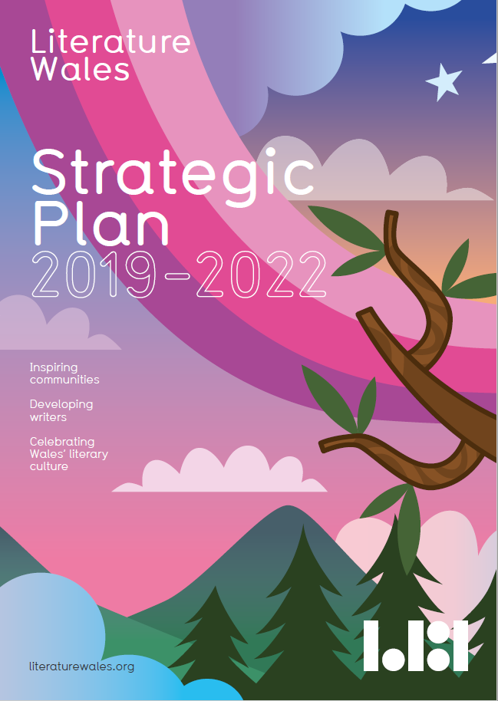
Highlights
Organisational
Strategic Plan 2019-2022 launched at Hay Festival in May
Partnership working with Books Council Wales strategy paper submitted to Welsh Government
Weston Jerwood Socio-Economic Diversity & Inclusion in the Arts Tool-kit launched in Manchester, featuring Literature Wales as a case study
Organisational Review consultation sessions took place with the SMT and staff
Activity
Gruffudd Owen announced as the new Bardd Plant Cymru 2019-21
Hay Writers at Work Industry Day saw 20 writers receive bespoke training
Wales Book of the Year ceremony took place in Aberystwyth with £12,000 awarded to winning authors
21 applications received for the new Children’s Laureate Wales
Literature for Health & Well-being call-out received 68 applications and 10 successful projects were granted funding
Weird & Wonderful Wales exhibition tour opened in Galeri Caernarfon, stopping at 6 Cadw sites through the summer
Platforming Under-represented Writers call-out launched to an overwhelmingly positive response from the sector
Operational
2019-2022 Fundraising Strategy came into effect
Arts and Business Fundraising Internship application successful - the 10 month placement starts in October
Financial audit took place
Nant Redevelopment completed
Fresh round of Critical Friends interviews has commenced
LW online shop was launched
Inaugural Advisory Group held

Slide 4

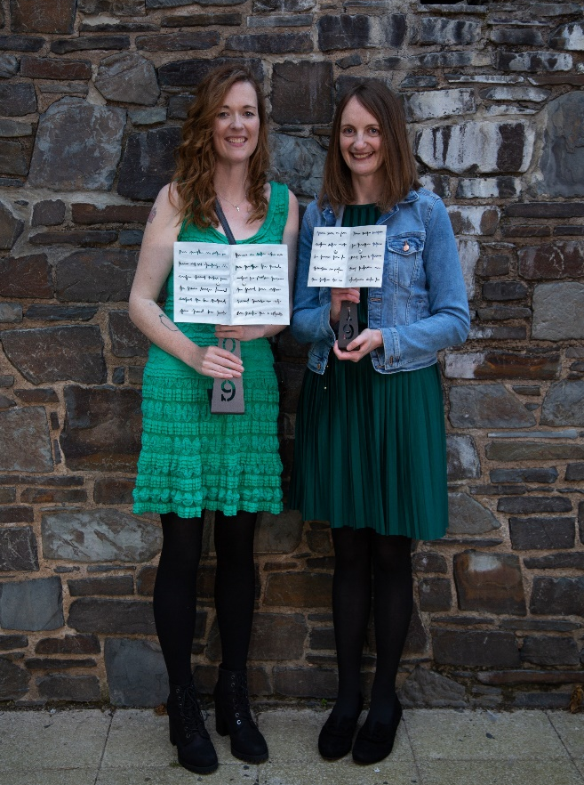
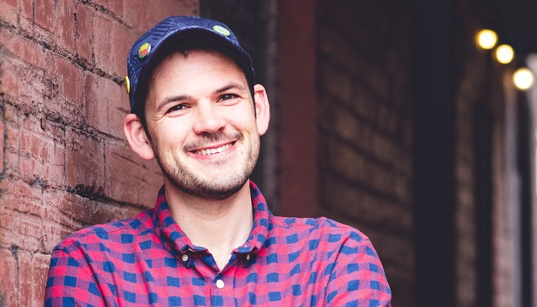
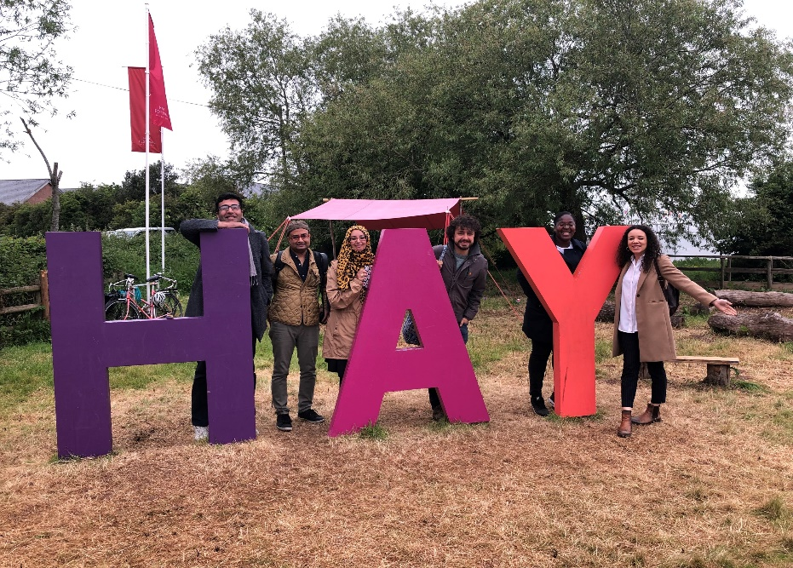
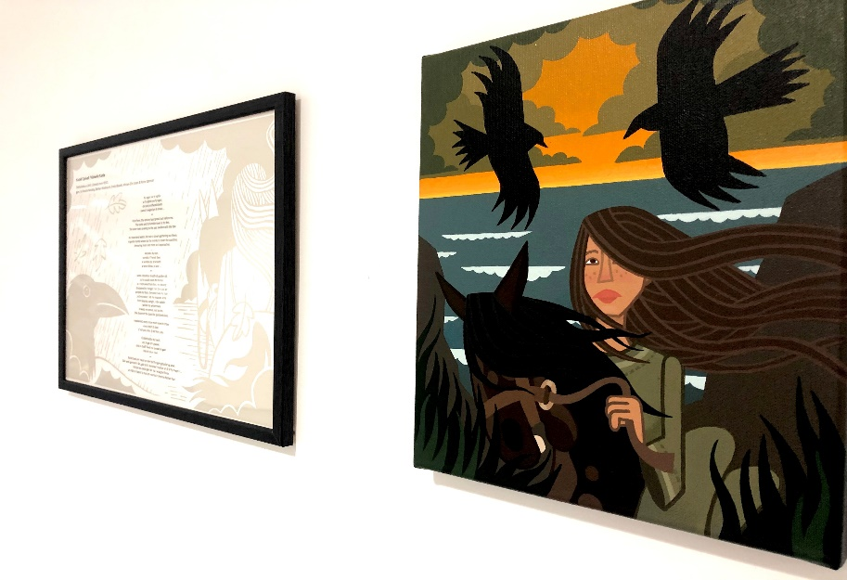
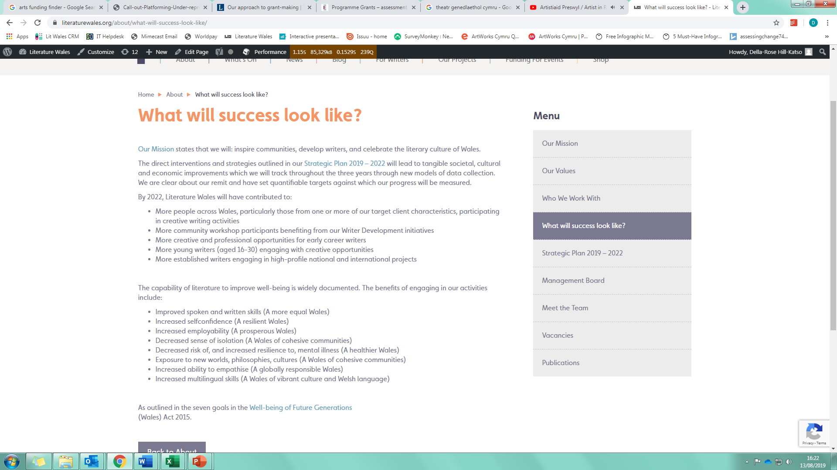
Literature Wales & Cadw created a video about the Young Residency Partnership Project. The project has been developing since 2015, initially with National Trust and now includes Cadw and Theatr Genedlaethol Cymru:
Click here to watch the video
Gruffudd Owen announced as new Bardd Plant Cymru 2019-21
Bardd Plant Sleepover at Tŷ Newydd Writing Centre
Ailbhe Darcy and Manon Steffan Ros win Wales Book of the Year 2019
Weird & Wonderful Wales exhibition tour
Literature Wales funds Cardiff-based spoken word night ‘Where I’m Coming From’ writers to attend the Hay Festival
Literature Wales’ website is updated to reflect Strategic Plan

Slide 5

Organisational Impact & Outcomes
 | Target for 31 March 2020 | Current Progress 1 April – 31 July 2019 | Method of data capture
Organisational Impact | We will be on our way to empowering, improving and brightening the lives of our clients, contributing to their greater well-being and that of Wales’ society, economy and culture | The longitudinal survey for the three years has been created and sent to a representative sample of 10 clients, who have been contracted to complete it twice a year. Baseline outcomes will be available for Report #2. | 2019-22 Longitudinal Survey
Organisational Outcomes | Our clients will be on their way to having: Improved spoken and written skills Increased self-confidence Increased employability A decreased sense of isolation A decreased risk of, and increased resilience to, mental illness Exposure to new worlds, philosophies, cultures Increased ability to empathise Increased multilingual skills

Slide 6
Organisational Outputs
Activity Key Measures of Success: Participation
Targets for 31 March 2020 | Current Progress 1 April – 31 July 2019 | Method of data capture
The proportion of Wales’ population participating in creative writing has increased by 0.6 percentage points to 8.8% by 2020, equating to an extra 20,700 people | The Arts Council of Wales Omnibus Survey on arts participation for 2019 will be published in March/April 2020. | Arts Council of Wales Omnibus Survey on arts participation
At least 106,000 creative participants and audience members engage in our activity annually | Since 1 April 2019, 8,567 creative participants and audience members have engaged with a Literature Wales delivered or supported activity. This figure will increase substantially within the next six months when key perennial participation projects (e.g. Lit Reach; Literature for Well-being) restart their delivery phases | Our project progress and evaluation reports
At least 17% of our creative participants identify with one or more of our Target Client Characteristics | We are currently finalising plans to roll-out our Equalities & Diversity form to measure this. The form will be distributed to a representative sample of participants in workshops and events we directly deliver, partner on and facilitate, with the option to complete it digitally. | Our project progress and evaluation reports and Equality & Diversity monitoring
At least 17 creative participants are directed to our writer development opportunities annually | 56 creative participants have so far been directed to our writer development opportunities. For example, each of the 11 participants on the Emerging Writers course at Tŷ Newydd Writing Centre received a bespoke one-to-one meeting with the Head of Tŷ Newydd, focusing on writer development opportunities, including Writers’ Bursaries, Shadowing, Platforming Under-represented Writers and more. | Our project progress and evaluation reports

Slide 7
Organisational Outputs
Activity Key Measures of Success: Writer Development
Targets for 31 March 2020 | Current Progress 1 April – 31 July 2019 | Method of data capture
We provide at least 140 creative and professional opportunities for early career writers annually | We have so far provided 50 creative and professional opportunities for early career writers. For example, in May 2018, Literature Wales collaborated with the Hay Festival to offer attendees of Cardiff-based Spoken Word group ‘Where I’m Coming From’ funded transport and tickets. The early career writers attended events, networked and met with established authors. | Our project progress and evaluation reports
There are at least 5,000 unique page views of our online writer development information annually | There have been 10,487 unique page views and 13,662 total page views of our online Writer Development information in this period. 27% of these page views were the result of our new approach to call-outs. | Google analytics
A total of 4 young writers (aged 16-30) are provided with sustained support annually | 9 out of the 26 writers on the Writers Bursaries & Mentoring Scheme 2019 that are currently receiving financial support were under 30 at the time of submitting their application. 1 of these bursaries was specifically ring-fenced for a writer under the age of 25. | Our project progress and evaluation reports

Slide 8
Organisational Outputs
Activity Key Measures of Success: Wales’ Literary Culture
Targets for 31 March 2020 | Current Progress 1 April – 31 July 2019 | Method of data capture
At least 15 established writers and 17 literary works are engaged in high-profile projects annually | 17 established writers have engaged in a high-profile projects since 1 April 2019. For example, Oliver Bullough - regular contributor to the Guardian and author of Sunday Times Bestseller & Business Book of the Year ‘Moneyland’ - won the Creative Non-fiction Category at Wales Book of the Year 2019. 18 literary works were featured on the shortlist for Wales Book of the Year 2019 and 7 of these were winning titles. Overall, 143 literary works were submitted for the award. | Our project progress and evaluation reports
We will collaborate on and facilitate at least 2 partnership and exchange projects outside Wales annually | We have led and facilitated 3 partnership projects outside of Wales. For example, in June 2019, award winning Welsh novelist Alys Conran took part in two events in Berlin, with support from British Council Wales’ Wales Europe 2019-2020 fund.
Through our intervention, at least 2 commissions per year are awarded to established writers by other organisations | To date, 1 established writer has been awarded commissions by other organisations through our intervention - the British Council commissioned Rufus Mufasa to perform her work at the Makassar International Writers Festival in Indonesia in June 2019.
A minimum of 2 early career writers engage with our high-profile opportunities annually | 1 early career writer has engaged with our high-profile opportunities so far. Mari Ellis Dunning’s Poetry Collection was shortlisted for Wales Book of the Year 2019. She has written about her experience here.

Slide 9
Organisational Outputs
Operational Measures of Success: Monitoring & Evaluation
Targets for 31 March 2020 | Current Progress 1 April – 31 July 2019 | Method of data capture
70% of our data from our activity and operational projects is stored in our central monitoring & evaluation (M&E) hub | The M&E central hub holds qualitative and quantitative data including client feedback, demographic break-down and general engagement figures. The Development & Communications Officer currently inputs this data - staff will do this directly from the start of 2020. There are currently 516 quotes/feedback under the Writer Development Activity Pillar, 193 for Participation and 53 for Wales’ Literary Culture. There are 190 sets of numerical data. It is estimated that currently 20% of our data is recorded in the M&E central hub. In July 2019, we purchased an annual (discounted) membership to Survey Monkey which will support greater centralisation of data through the year. | Our project progress and evaluation reports and annual MARCOMMs survey
1 Annual Report communicating our impact has been circulated | The Annual Report has been circulated for approval at the Management Board meeting #33.
12 monthly and 4 quarterly evaluation reports have been produced | This is the first of the quarterly evaluation reports. We’re working on the monthly reports (which focus on progress towards project KPIs for SMT attention) as part of the Project Management system development. These will be rolled out during the autumn. Project and organisational learning points will be added as new sections to the monthly and quarterly reports respectively.
70% of new or perennial projects are pitched to SMT, and all reference learning points from our analysis | The Head of Communications and Head of Development & CEO are working on a formal project pitching process. Two potential new partnership projects have been proposed and discussed at SMT meetings in this period, representing approximately 66% of the new projects currently in development.

Slide 10
Organisational Outputs
Operational Measures of Success: Human Resources
Targets for 31 March 2020 | Current Progress 1 April – 31 July 2019 | Method of data capture
40% staff have attended at least 3 cross-team training sessions | 1 cross-team training session has so far taken place, attended by 35% of the staff (SMT Finance Training). Further sessions are being planned. | Our project progress and evaluation reports
At least 2 staff have benefitted from sustained professional development opportunities (e.g. courses) | 2 staff have benefitted from sustained professional development opportunities. Our Finance Officer is currently undertaking an AAT Level 4 accountancy qualification. The Venue Manager based at Tŷ Newydd Writing Centre is currently 2/3rds of the way through a CIM accredited Marketing and Communications Level 4 qualification.
Staff job satisfaction ratings have increased by at least 7% | A staff well-being survey will be conducted after the Organisational Review and as part of the Staff Well-being Plan. This will provide baseline data for this target. | Company culture analysis as part of the Staff Well-Being Plan and the PDRs
At least 5% of our employees, volunteers , contractors and Directors identify as BAME and 5% have disabilities, and 1 of these is in a senior position on the staff and Board (pending vacancy availability) | We are currently finalising plans to roll-out our Equalities & Diversity form to measure this. Directors received an Equality and Diversity questionnaire in July. Staff will be sent a questionnaire in September 2019. This will provide baseline data for this target. | Our project progress and evaluation reports
We will have worked with at least 7 volunteers | We have had 1 volunteer in the Tŷ Newydd office so far, with another 2 Erasmus+ interns from Humboldt University, Germany, and 1 Arts & Business Fundraising Intern scheduled to work from the Cardiff office in the autumn. An offer for another from Open University is currently being explored. We have also worked with 12 volunteers at Singleton Hospital, Swansea and 4 volunteers through Conwy Library Service as part of the Reading Friends Project.

Slide 11
Organisational Outputs
Operational Measures of Success: Tŷ Newydd Writing Centre Business
Targets for 31 March 2020 | Current Progress 1 April – 31 July 2019 | Method of data capture
Friends of Tŷ Newydd Scheme launched, and at least 30 new Friends join | This work is pending the Marketing & Communications Officer appointment and will be started in autumn/winter.
New specifications of works created by architects for repairs needed on the conservatory | This is in the early stage of discussion with architects, with the approximate fee for the specifications forecast within the 2019/20 Tŷ Newydd Works cost centre. | Our project progress and evaluation reports
2 bedrooms refurbished to a high-standard | This is in the early stage of development, with the project budget forecast within the 2019/20 Tŷ Newydd Works cost centre.
At least 85% of Tŷ Newydd Course attendees agree that their visit helped them progress as an author, and 90% state that they will return to the centre in the future | This data is collated and analysed annually as the attendees receive a feedback form six months after they complete a course. The results will be presented in Report #4.

Slide 12
Organisational Outputs
Operational Measures of Success: Governance & Consultation
Targets for 31 March 2020 | Current Progress 1 April – 31 July 2019 | Method of data capture
Survey a representative pool of at least 70 individuals from stakeholder groups and representing strategic partners at least once a year | We are currently working with Resilience Programme Associates Charles Beckett and Sarah Drummond on a stakeholder survey to be distributed in autumn 2019. | Our project progress and evaluation reports
Interview or discuss our work with a representative network of at least 15 Critical Friends at least once a year | We developed a new interview script for our Critical Friends which addresses their thoughts on the Strategic Plan and how it can be delivered. Interviews with 9 Critical Friends took place in July, with more planned for August. A report to summarise findings will be created and shared in September.
Convene 2 Management Board Advisory Group meetings, 10 SMT Operations meetings and 1 cross-staff Creative Planning session annually | 1 Programmes Advisory Group meeting was held with John O’Shea, Christina Thatcher and Cathryn Summerhayes on 17 July and focused on the international and the participation strategies. The first Communication Advisory Group meeting is planned for the autumn. 2 Operations-focused SMT meetings have so far taken placed: focusing on Finance and Risk. More are planned for the autumn. The next cross-staff Creative Planning session is taking place in Powys on 5 September.
Share analysis of stakeholder feedback via monthly and quarterly evaluation reports, and reference it in decision-making | This is the first of the quarterly evaluation reports. We’re working on the monthly reports (which focus on progress towards project KPIs for SMT attention) as part of the Project Management system development. These will be rolled out during the autumn. Project and organisational learning points will be added as new sections to the monthly and quarterly reports respectively. These will include stakeholder feedback. | Project pitches and meeting minutes

Slide 13
Organisational Outputs
Operational Measures of Success: Sector Facilitation
Targets for 31 March 2020 | Current Progress 1 April – 31 July 2019 | Method of data capture
Directly deliver no more than 10 projects annually | Literature Wales is currently directly delivering 10 projects: Llên Pawb | Lit Reach; Writer Training; Writer Shadowing; Tŷ Newydd Writing Squad; Writers’ Bursaries; Mentoring Scheme; Children’s Laureate Wales; Wales Book of the Year; Tŷ Newydd Creative Writing Courses; and National Poet of Wales. All other projects are delivered in partnership (Literature Wales is joint partner) or on a facilitative model (Literature Wales provides support / funding / acts as hosts only or is a secondary partner). | Our project progress and evaluation reports
Support at least 20 partner-led projects as facilitators or secondary partners annually | We have so far supported 35 partner-led projects as facilitators or secondary partners. For example, in July we supported and co-hosted the Breaking New Ground: UK Tour, an invaluable new resource which champions and celebrates over 100 British children’s writers and illustrators of colour.
Provide funding and/or in-kind support to at least 150 individuals, groups and organisations annually | We have so far completed over 280 hours of facilitation work for the sector, to 222 individuals, groups and organisations. This figure includes Writers on Tour supported events and the 2019 Writers’ Bursaries cohort.
Have stimulated at least 4 new self-run sustainable literary projects in areas of need | 2 new self-run sustainable literary projects in areas of need have been stimulated. For example, as a result of their engagement with the Lit Reach project, Gwynedd and Anglesey Library Services are planning creative writing workshops for the autumn.

Slide 14
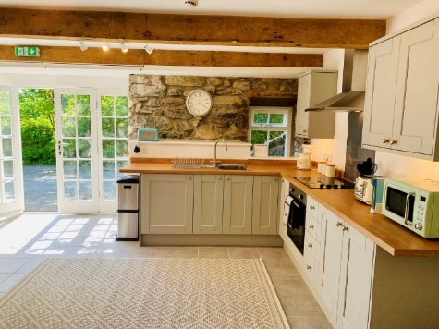
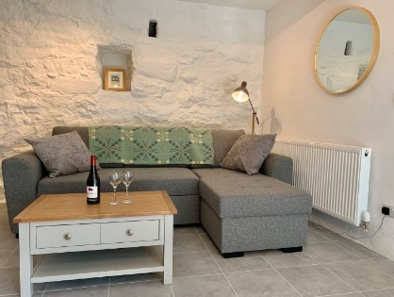
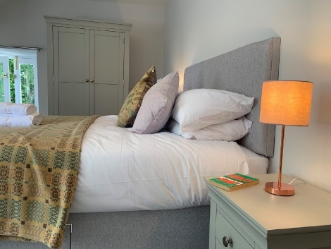
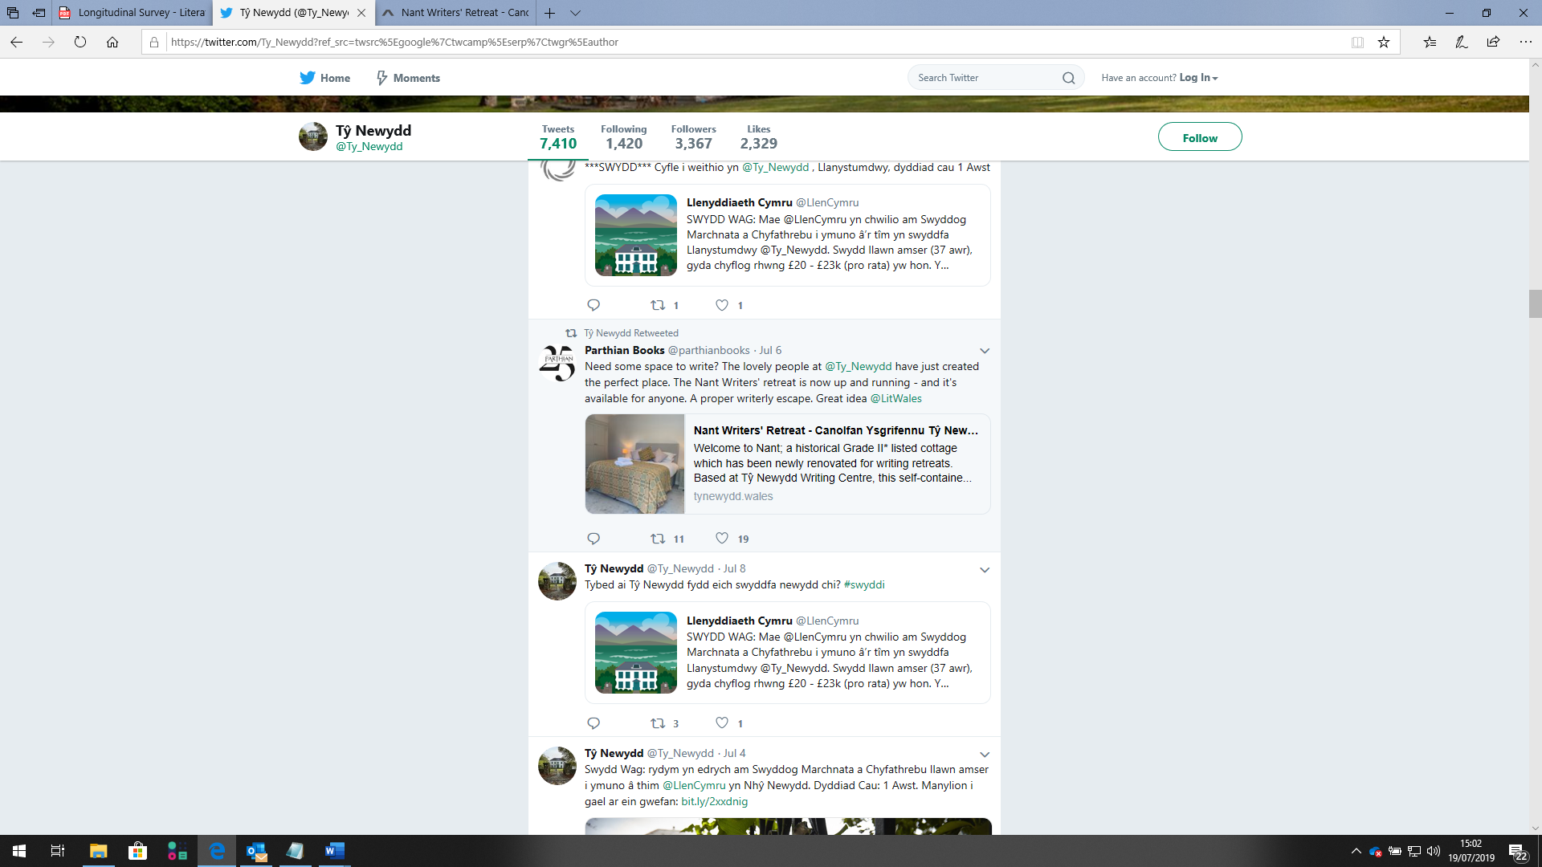
Additional ACW funding requirements
Nant Redevelopment
Targets for 31 March 2020 | Current Progress 1 April – 31 July 2019 | Method of data capture
Redevelopment of Nant Cottage completed and open to customers by August 2019 | The redevelopment of Nant was completed on 28 June 2019. It has been receiving paid guests since 6 July and is booked out until September – a combination of private hire (due to the potential of last-minute summer holiday bookings), additional course capacity and writing retreats. The communications campaign is underway. | Nant update reports and our quarterly accounts

